Slide 1

Online Grocery Ordering System

Slide 2
Guided by: Ms. Sushmita Meena From: Mr. Lonkar Atul Vitthal PRN Number 220950320071 Mr. Masule Abhimanyu Anil PRN Number 220950320073 Mr. Mayank kumar Ujjain PRN Number 220950320074 Mr.Mohd Nadeem Siddiqui PRN Number 220950320076 Mr. Owaish Mustaque Khan PRN Number 220950320077

Slide 3
Introduction of Project
The "Online Grocery Ordering System" has been developed to override the problems prevailing in the practicing manual system. This software is supported to eliminate and in some cases reduce the hardships faced by this existing system. Moreover this system is designed for the particular need of the company to carry out operations in a smooth and effective manner.
The application is reduced as much as possible to avoid errors while entering the data. It also provides error message while entering invalid data. No formal knowledge is needed for the user to use this system. Thus by this all it proves it is user-friendly. Online Grocery Ordering System , as described above, can lead to error free, secure, reliable and fast management system. It can assist the user to concentrate on their other activities rather to concentrate on the record keeping. Thus it will help organization in better utilization of resources.

Slide 4
Abstract of Project
The purpose of Online Grocery Ordering System is to automate the existing manual system by the help of computerized equipment's and full-fledged computer software, fulfilling their requirements, so that their valuable data/information can be stored for a longer period with easy accessing and manipulation of the same. The required software and hardware are easily available and easy to work with.
Online Grocery Ordering System, as described above, can lead to error free, secure, reliable and fast management system. It can assist the user to concentrate on their other activities rather to concentrate on the record keeping. Thus it will help organization in better utilization of resources. The organization can maintain computerized records without redundant entries. That means that one need not be distracted by information that is not relevant, while being able to reach the information.

Slide 5
Objective of Project
Provides the searching facilities based on various factors. Such as Grocery, Grocery Company, Customer, Payment
Online Grocery Ordering System also manage the Order details online for Customer details, Payment details, Grocery.
It tracks all the information of Grocery Type, Order, Customer etc
Manage the information of Grocery Type
Shows the information and description of the Grocery, Grocery Company
To increase efficiency of managing the Grocery, Grocery Type
It deals with monitoring the information and transactions of Customer.
Manage the information of Grocery
Editing, adding and updating of Records is improved which results in proper resource management of Grocery data.

Slide 6
Scope of Project
In computer system the person has to fill the various forms & number of copies of the forms can be easily generated at a time.
In computer system, it is not necessary to create the manifest but we can directly print it, which saves our time.
To assist the staff in capturing the effort spent on their respective working areas.
To utilize resources in an efficient manner by increasing their productivity through automation.
The system generates types of information that can be used for various purposes.
It satisfy the user requirement
Be easy to understand by the user and operator
Be easy to operate

Slide 7
Existing Project
In the existing system the exams are done only manually but in proposed system we have to computerize the exams using this application.
Lack of security of data.
More man power.
Time consuming.
Consumes large volume of pare work.
Needs manual calculations.
No direct role for the higher officials

Slide 8
Proposed System
The aim of proposed system is to develop a system of improved facilities. The proposed system can overcome all the limitations of the existing system. The system provides proper security and reduces the manual work.
Security of data.
Ensure data accuracy’s.
Proper control of the higher officials.
Minimize manual data entry.
Minimum time needed for the various processing.
Greater efficiency.
Better service.

Slide 9
Modules of the Project
Grocery Management Module: Used for managing the Grocery details.
Payment Module : Used for managing the details of Payment
Order Module : Used for managing the details of Order
Grocery Type Management Module: Used for managing the information and details of the Grocery Type.
Grocery Company Module : Used for managing the Grocery Company details
Customer Module : Used for managing the Customer information
Login Module: Used for managing the login details
Users Module : Used for managing the users of the system

Slide 10
Report of the Project
It generates the report on Grocery, Grocery Type, Order
Provide filter reports on Grocery Company, Customer, Payment
You can easily export PDF for the Grocery,Order, Customer
Application also provides excel export for Grocery Type, Grocery Company, Payment
You can also export the report into csv format for Grocery, Grocery Type, Payment

Slide 11
Software Requirements Specification
Name of component | Specification
Operating System | Windows 98, Windows XP, Windows7, Linux
Language | Java
Database | MongoDB
Browser | Any of Mozilla, Opera, Chrome etc
Web Server | Apache2
Software Development Kit | WAMP or XAMP
Scripting Language Enable | JSP
Database Driver | MongoDB

Slide 12
Hardware Requirements Specification
Name of component | Specification
Processor | Pentium III 630MHz
RAM | 128 MB
Hard disk | 20 GB
Monitor | 15” color monitor
Keyboard | 122 keys

Slide 13
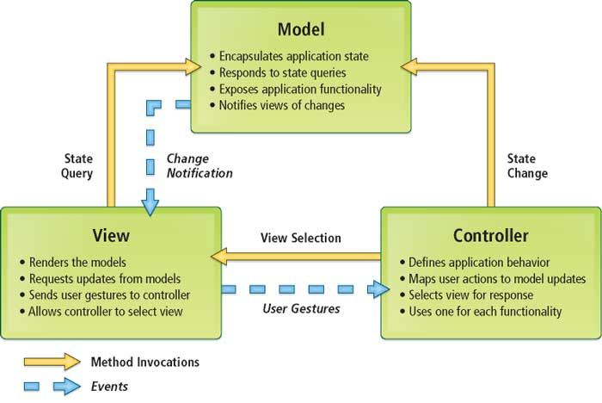
Implementation Methodology

Slide 14
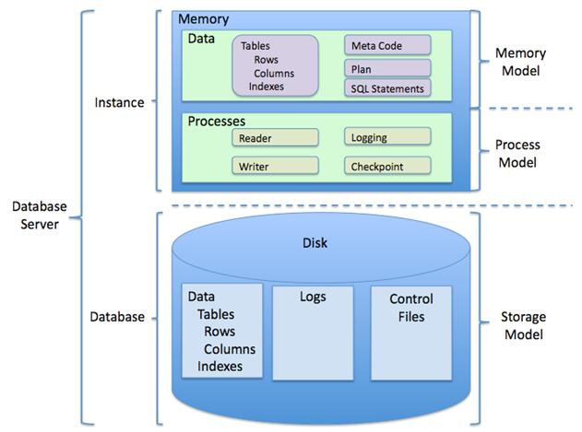
Project Category

Slide 15
Project Category

Slide 16
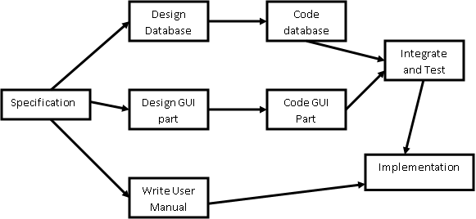
Pert Chart

Slide 17
Conclusion of the Project
Our project is only a humble venture to satisfy the needs to manage their project work. Several user friendly coding have also adopted. This package shall prove to be a powerful package in satisfying all the requirements. The objective of software planning is to provide a frame work that enables the manger to make reasonable estimates made within a limited time frame at the beginning of the software project and should be updated regularly as the project progresses.
A description of the background and context of the project and its relation to work already done in the area.
Made statement of the aims and objectives of the project.
The description of Purpose, Scope, and applicability.
We define the problem on which we are working in the project.
We describe the requirement Specifications of the system and the actions that can be done on these things.

Slide 18
Future Scope of the Project
In a nutshell, it can be summarized that the future scope of the project circles around maintaining information regarding:
We can add printer in future.
We can give more advance software for Railway Reservation System including more facilities
We will host the platform on online servers to make it accessible worldwide
Integrate multiple load balancers to distribute the loads of the system
Create the master and slave database structure to reduce the overload of the database queries
Implement the backup mechanism for taking backup of codebase and database on regular basis on different servers

Slide 19
Limitation of Project
Although I have put my best efforts to make the software flexible, easy to operate but limitations cannot be ruled out even by me. Though the software presents a broad range of options to its users some intricate options could not be covered into it; partly because of logistic and partly due to lack of sophistication. Paucity of time was also major constraint, thus it was not possible to make the software foolproof and dynamic. Lack of time also compelled me to ignore some part such as storing old result of the candidate etc.
Considerable efforts have made the software easy to operate even for the people not related to the field of computers but it is acknowledged that a layman may find it a bit problematic at the first instance. The user is provided help at each step for his convenience in working with the software.

